Slide 1
Light Absorption Measurements in the Chemical Speciation Network (CSN)
Nicholas Spada, Nicole Hyslop, Jason Giacomo
UC Davis Air Quality Research Center

Slide 2
Summary
The Hybrid Integrating Plate/Sphere (HIPS) instrument has been used for measuring light absorption by PM_{2.5} samples in the IMPROVE network (Interagency Monitoring of PROtected Visual Environments) since 1994
Exploratory HIPS analyses were performed on Chemical Speciation Network (CSN) samples beginning with 2018 sample dates
HIPS filter absorption (f_{abs}) measurements provide an estimate of the light absorbing capacity of the ambient PM_{2.5}, important for visibility and climate forcing
f_{abs} measurements correlate well with elemental carbon (EC) measurements, thus providing a validation check for the quartz samples

Slide 3
Hybrid Integrating Plate/Sphere (HIPS)
  Incident light: 633 nm (red) He-Ne laser
  Sample deposit faces AWAY from incident light
  Measures both reflectance and transmittance
    Reflectance (r) approximates zero absorption
    Transmittance (t) indicates attenuation by sample
  Opal glass captures forward scattering
Similar to other light integrating techniques, e.g.
  Laser Integrating Plate Method (LIPM)
  Aethalometer
  Particle Soot Absorption Photometer (PSAP)

Slide 4
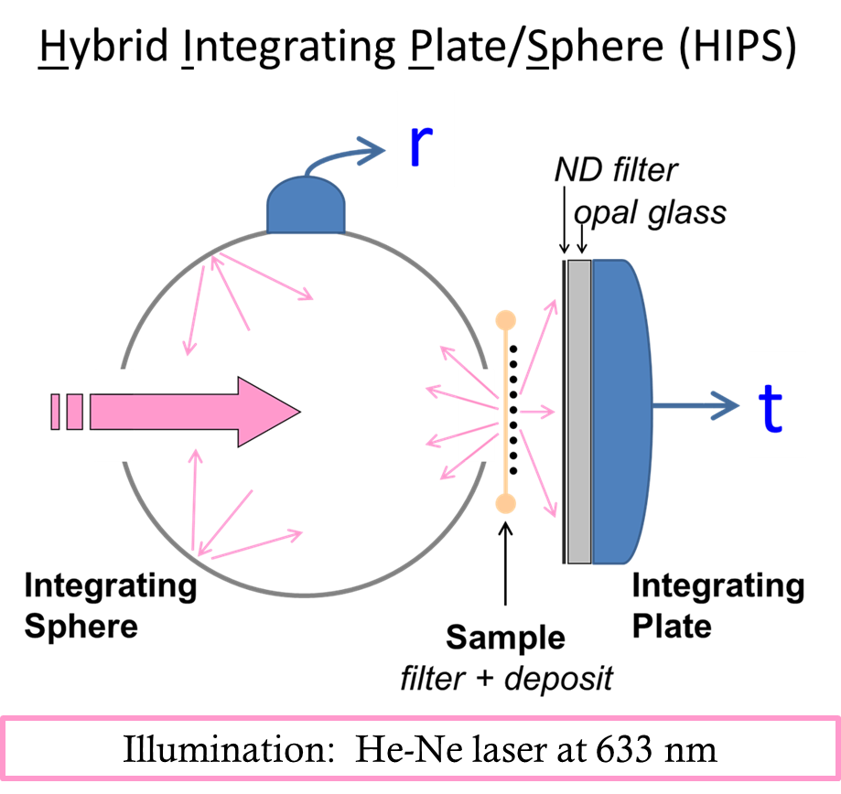
A visual representation of the HIPS method.
Light produced by a HE-Ne laser (633 nm) is introduced into a 4-inch integrating sphere made of Spectralon, a reference material for diffuse reflectance .
The light first interacts with the back side of the PTFE filter membrane (i.e., sample deposit is facing away from the incident light). This configuration provides an estimate of the filter background signal without an absorbing deposit.
Reflected light is collected in the integrating sphere and detected by the reflectance detector (r).
Light transmitted through the filter membrane interacts with the PM deposit. Some light is absorbed, some passes directly through, and some is scattered in the forward and backward directions.
Transmitted and forward scattered light is collected by an opal glass integrating plate and detected by the transmittance detector (t).
Laser light

Slide 5
Filter Absorption Theory
Ambient particulate matter (PM) is collected into non-absorbing polytetrafluorethylene (PTFE) filters forming a poly-disperse layer of deposited particles
Incident light interacting with the PM will either scatter (in the forward and backward directions) or be absorbed.
Field blanks account for light lost in the analytical instrument and form the basis of the instrument’s calibration.

Slide 6
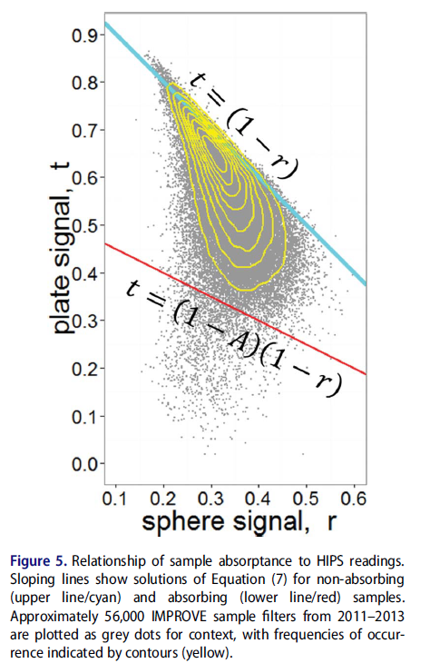
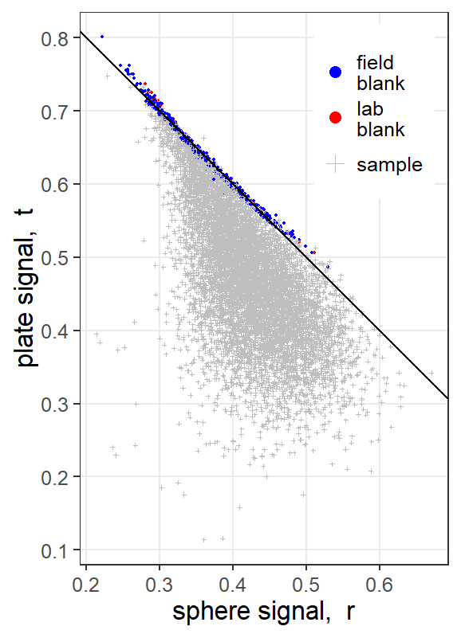
Optical Relationship Between Reflectance and
Transmittance
The PTFE filter membrane is known to be non-absorbing; therefore, the power readings from the transmission and reflectance detectors are scaled (calibrated) such that
t + r = 1.
Ambient PM samples absorb some amount of light. The absorbed light does not reach the plate (transmission) or sphere (reflectance) detector, and therefore these t and r measurements fall below this calibration line.

Slide 7



Method Precision and Long-Term Stability
The HIPS analysis provides precise and repeatable data, as determined by collocated precision and replicate analysis of samples, respectively
Exploratory analyses show higher precision for IMPROVE samples than CSN samples, due to the differences in sampling methodology; i.e., 25 mm filter sampling at 23 L/min for IMPROVE as opposed to 47 mm filter sampling at 6.7 L/min for CSN
Reanalysis of archived PM samples showed good agreement with the original analyses, as shown in the next slide

Slide 8
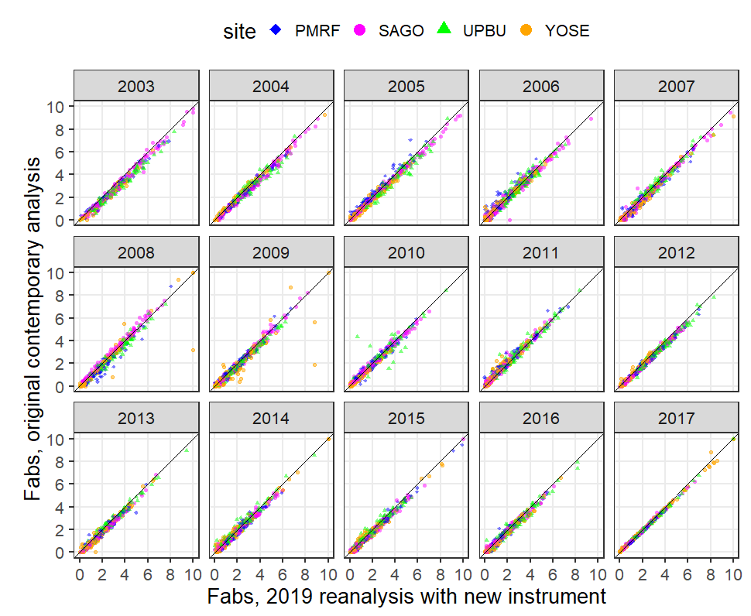
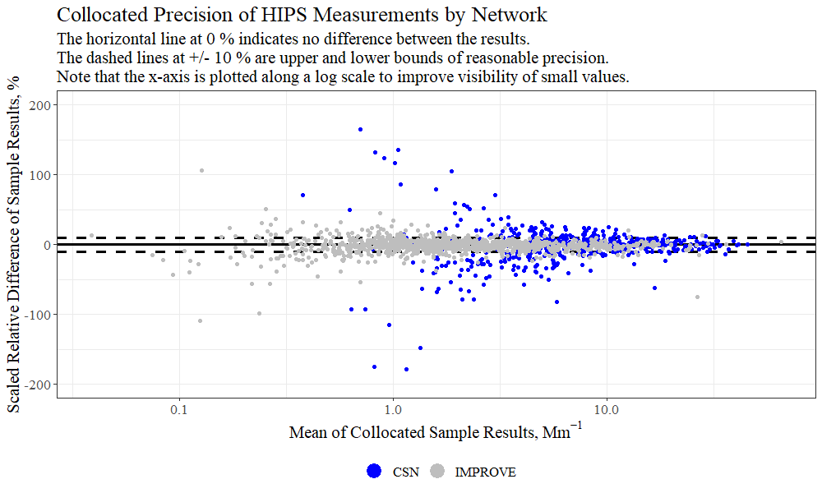
Collocated precision estimates are determined by calculating the scaled relative difference (SRD) between samples collected at the same location and same time. The SRD is the ratio of scaled arithmetic difference, (X₁-X₂) / sqrt(2), divided by the mean of the 2 measurements, (X₁+X₂)/2. The sqrt(2) term accounts for combined error in both measurements. We expect the SRD to increase as the measurement values approach the detection limit.
This graph compares the original filter absorption results (y-axis) to reanalysis results (x-axis) performed after the samples were archived for several years. This comparison demonstrates the stability of the HIPS analytical results over time despite lacking NIST-traceable standards. Different symbols represent different IMPROVE sites.

Slide 9
Inter-
Sampler Comparisons
Light absorption measurements on the PTFE (Teflon®) filters are compared with other measurements for data validation.
  Light absorption measurements are compared with thermal/optical analysis (TOA) results from PM collected on quartz filters - specifically, elemental carbon determined by TOA with optical reflectance (ECTR) correction and the “black carbon” estimate (BC) calculated from TOA laser attenuation.
In the next figure, HIPS absorption is scaled with an assumed mass absorption coefficient of 10 m²/g and compared with ECTR and BC by TOA for samples collected at the North Little Rock Arkansas site (AQS ID 15-119-0007)
All 3 parameters trend together temporally with periods of diversion. Disagreements between these parameters can identify operational deviations such as filter swaps or aberrant sampling conditions

Slide 10
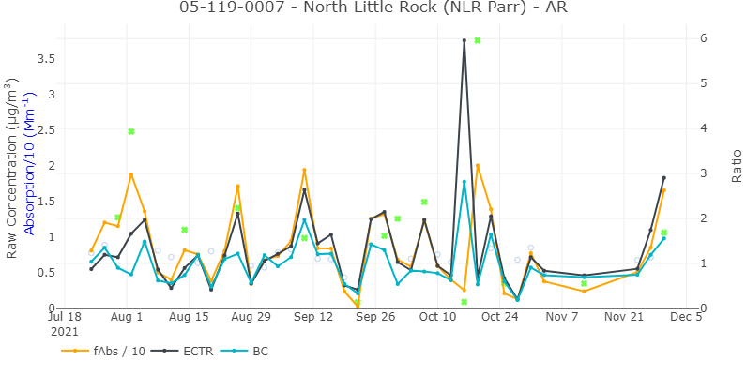
Time-series plot showing light absorption results from HIPS (orange) and TOA (ECTR in black and BC in blue) analyses of samples collected at the North Little Rock, Arkansas, CSN site. The points show the ratio of ECTR with HIPS; gray circles indicate values within the expected range and green squares indicate high or low ratios. Typically, all three parameters trend well together. On the October 16th and 19th sample dates, the inter-sampler results disagree. A pair of consecutive mismatches with one high and the other low suggest an inadvertent swap between the two quartz samples, whose filters lack integral QR codes. These instances are investigated and corrected if sufficient evidence is found.

Slide 11
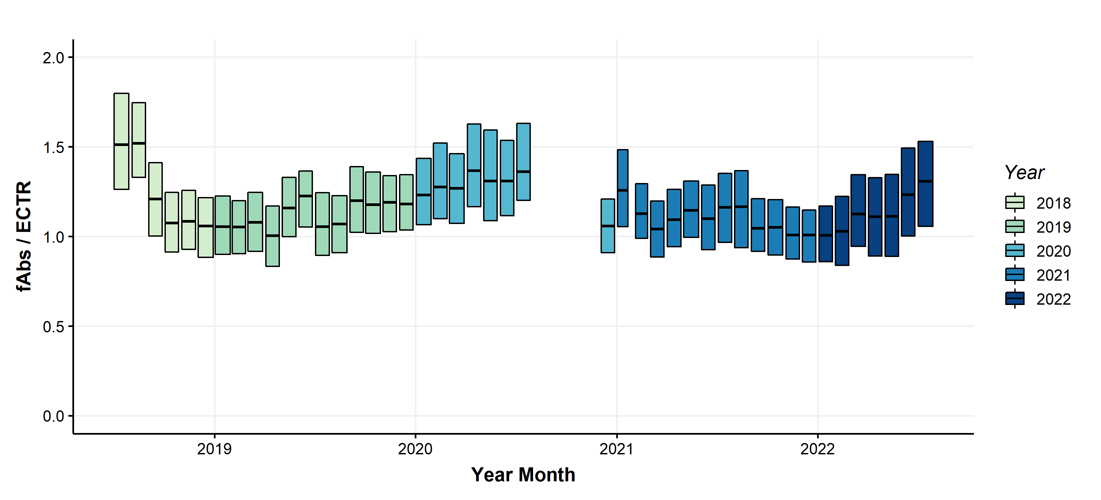
Ratio of HIPS Filter Absorption (fAbs/10) to TOA EC
Boxes span the 25th to 75th percentile range for each month for all sites in CSN, and the horizontal lines indicate the median values.
Changes in the ratios can occur as a result of changes in analytical instrumentation, analytical techniques, or atmospheric composition.
Light absorption measurements were not performed for a few months in late 2020 as a result of Covid-related shutdowns.

Slide 12
Acknowledgements & Reference
This work was supported by the US Environmental Protection Agency (cooperative agreement grant #P21AC11294-00). The assumptions, findings, conclusions, judgements, and views presented herein are those of the authors and should not be interpreted as necessarily representing the Environmental Protection Agency’s policies
White, W. H., Trzepla, K., Hyslop, N. P., and Schichtel, B. A.: A critical review of filter transmittance measurements for aerosol light absorption, and de novo calibration for a decade of monitoring on PTFE membranes, Aerosol Sci. Tech., 50, 984–1002, 2016, https://doi.org/10.1080/02786826.2016.1211615.

